Slide 1

CHAPTER
Protocols and IEEE Standards

Slide 2
Chapter Objectives
Discuss different media level protocols including their functioning
The major protocols chosen for discussion are as follows:
  CSMA/CD, token passing and polling
Discuss the IEEE standards that apply to LANs based on different protocols

Slide 3
Chapter Modules
LAN Protocol: Carrier Sense Multiple Access/Collision Detection (CSMA/CD)
LAN Protocol: Token Passing
LAN Protocol: Polling
IEEE Standards

Slide 4

END OF CHAPTER INTRODUCTION

Slide 5
MODULE
IEEE and Lower Layer LAN Protocols

Slide 6
IEEE Background
Institution of Electrical and Electronic Engineering (IEEE)
A professional non-profit organization
Project group 802 under IEEE
  Entrusted with the task of setting standards relating to physical and logical links of nodes in a network
Standard mostly applies to the Physical and Data Link layers
Example
  IEEE 802.3 standard for the Ethernet bus network

Slide 7
The ISO-OSI Model Recalled
Models the end-to-end communication process
It is a seven-layer model
Proposed by International Standard Organization (ISO)
The model is known as Open Systems Interconnect (OSI)
IEEE sets the standards at the lower levels of the ISO-OSI model

Slide 8
ISO-OSI Seven Layer Model
Layer 7
Application
Layer 6
Presentation
Layer 5
Session
Layer 4
Transport
Layer 3
Network
Focus of
IEEE 802
Layer 2
Data Link
Layer 1
Physical
Source: http://starter.sdsu.edu/remote/demo/osi-tcp.html

Slide 9
Comparison of ISO-OSI Model and the DOD (TCP/IP) Model
Source: http://starter.sdsu.edu/remote/demo/osi-tcp.html
Application
Application
Presentation
Session
Transport
Host-to-Host
Network
Internet
Data Link
Network Access
Physical

Slide 10
Layer Reference to Protocol
Application
Application
FTP, Telnet, SMTP, HTTP, SNMP ..
Presentation
Session
Transport
Host-to-Host
TCP, UDP
Network
Internet
IP, ICMP
Data Link
Network Access
Ethernet, Token-Ring ...
Physical
Source: http://starter.sdsu.edu/remote/demo/osi-tcp.html

Slide 11
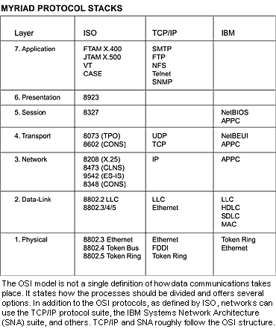
Network Protocols
Source: www.networkmagzine.com

Slide 12
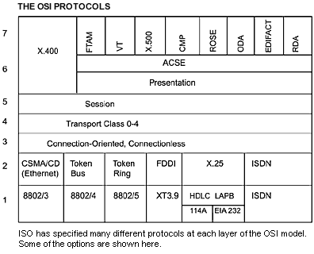
Another Look at Network Protocols
Source: www.networkmagzine.com

Slide 13
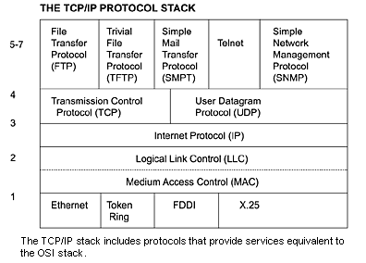
Network Protocols in the TCP/IP Model
Source: www.networkmagzine.com

Slide 14
IEEE 802 Focus
OSI Reference
  Data Link layer
  Physical layer
Areas of applications
  Network cards and cables
  WAN connectivity etc.
Different subgroups under 802 that focus on different activities of the LAN

Slide 15
IEEE 802 Subgroups and their Responsibilities
802.1
  Internetworking
802.2
  Logical Link Control (LLC)
802.3
  CSMA/CD
802.4
  Token Bus LAN
Continued

Slide 16
IEEE 802 Subgroups and their Responsibilities (Cont.)
802.5
  Token Ring LAN
802.6
  Metropolitan Area Network
802.7
  Broadband Technical Advisory Group
802.8
  Fiber-Optic Technical Advisory Group
Continued

Slide 17
IEEE 802 Subgroups and their Responsibilities (Cont.)
802.9
  Integrated Voice/Data Networks
802.10
  Network Security
802.11
  Wireless Networks
802.12
  Demand Priority Access LANs
  Ex: 100BaseVG-AnyLAN

Slide 18
Ethernet Protocol Standards
10 Mbps
  IEEE 802.3
100 Mbps
  IEEE 802.3u
1 Gbps
  IEEE 802.3ab
  Uses all 4 pairs of the RJ-45 cable (www.techfest.com/networking/lan/ethernet1.htm )
10 Gbps
  IEEE 820.3ae

Slide 19
Wireless LAN Protocols
802.11
  1-2 Mbps, 2.4 GHz, FHSS and DSSS
IEEE 802.11a
  54 Mbps, 5 GHz, Orthogonal Frequency Division Multiplexing
IEEE 802.11b
  11 Mbps, 2.4 GHz, DSSS
IEEE 802.11g
  20+ Mbps, 2.4 GHZ
  108 Mbps, 2.4 GHz (Extreme G)

Slide 20
Newer Wireless Protocol
IEEE 802.11n

Slide 21
A Perspective of IEEE 802 Standards in Network Communication
Logical
Link
Control
(LLC)
802.2
802.1 applies
to both.
Media
Access
Control
(MAC)
802.3
802.4
802.5
802.12

Slide 22
END OF MODULE

Slide 23
MODULE
LAN Lower Layer Protocol:
IEEE 802.3 Carrier Sense Multiple Access/ Collision Detection (CSMA/CD)

Slide 24
An Overview of CSMA/CD
CSMA/CD has two components as mentioned
First is the Carrier Sense Multiple Access (CSMA) component
Second is the Collision Detection (CD) component

Slide 25
CSMA Component of CSMA/CD
CSMA (Carrier Sense Multiple Access)
  Check the bus for traffic
  If the bus is free, then transmit
  If it is busy, wait for a random period of time before attempting to transmit again

Slide 26
CD Component of CSMA/CD
Two stations may check the data bus simultaneously
Both may find the line free and engage in the transmission of data
Both transmission will collide
CD component will detect this collision
  Inform the workstations of the collision
Each station will wait for a random period of time before attempting to transmit again

Slide 27
CSMA/CD Usage
Used extensively in bus LANs

Slide 28
CSMA/CD Standards
Highly standardized protocol
Different protocol standards for different speeds of communication
10 Mbps Ethernet standard
  IEEE 802.3

Slide 29
IEEE 802.3
10G bps Ethernet
  IEEE 802.3z
1G bps Ethernet
  IEEE 802.3ab
100M bps Ethernet
  IEEE 802.3u
10M bps Ethernet
  IEEE 802.3

Slide 30
END OF MODULE

Slide 31
MODULE
LAN Lower Layer Protocol:
IEEE 802.4 Token Bus Protocol

Slide 32
Token Bus
Server
Token
Client
Client
Client
A token is distributed to each client in turn.

Slide 33
Token Bus Data Pickup
A token is sent from one node to the other
The client wanting to transmit grabs an empty token
Data is attached
Token leaves for the next node and its travel on the bus until it reaches the address to which the data is destined
Cont.

Slide 34
Token Bus Data Delivery
Token delivers the data to the addressee
Acknowledgement is returned to the sender
Token is passed to the next node
The process continues
If there is an error in delivering the information, a request for retransmission attached to the token and it is sent to the sender

Slide 35
Token Bus Standard and Applications
IEEE 802.4
It can be used in both broadband and baseband transmission

Slide 36
END OF MODULE

Slide 37
MODULE
LAN Lower Layer Protocol:
IEEE 802.5 Token Passing Protocol

Slide 38
Token Passing Protocol in Operation
Circulating
Token
A
D
B
Server
Workstation
C
No collisions
Workstation

Slide 39
Comparison with CSMA/CD
Absence of collision
Offers a systematic method of transmitting information
In theory, it is superior to CSMA/CD
More sophisticated to implement
Protocols used in the newer and most popular networks are, however, based on CSMA/CD

Slide 40
The Token
Token
  Data packet that could carry data
  Circulates around the ring
  Offers an opportunity for each workstation and server to transmit data

Slide 41
The Transmitting Workstation
Waits for a free token in order to be able to attach the data to be transmitted to the token
On finding a free token, attach the following:
  Sender’s address
  Receiver’s address
  Data block to be transmitted
  Error checking details
  etc.

Slide 42
At the Receiving End
Data is received and checked for errors
Outcomes at the receiving end
  Data received without errors
  Date received with errors

Slide 43
Error-free Delivery of Data
An acknowledgment is attached to the token
Acknowledgment is passed to the sender
Token is set free for other nodes to transmit information
At this time, the next workstation on the ring will receive an opportunity

Slide 44
Correcting Errors in Delivery
A request for retransmission is attached to the token
Token carries the message for retransmission to the sender
The data is thus retransmitted

Slide 45
Token Regeneration
The token is regenerated at regular intervals to sustain the timing of circulation of the token

Slide 46
Usage of Token Passing
Used extensively in ring LANs
  Especially in the IBM token-ring LAN
A version of this protocol is also used on certain types of bus LANs
  Token-bus networks
Used in large fiber-optics backbones
  Used for the construction of very large networks

Slide 47
Usage in Practice
Used in backbones
Uses in a number of IBM shops
Overall, the usage of Ethernet surpasses the usage of Token-Ring networks that are based on the Token-Passing protocol

Slide 48
Token Passing Standards
IEEE 802.5
  For the token-ring LANs
IEEE 802.4
  For the token-bus LANs
A FDDI protocol is used on large fiber-optic ring backbones

Slide 49
END OF MODULE

Slide 50
MODULE
WAN Protocol: Token Passing on FDDI

Slide 51
ANSI X3T9.5 Protocol
This wide are network protocol is standardized by ANSI
Works similar to Token Passing Protocol
Used in FDDI and CDDI backbone networks
Usually implemented in dual-ring format for fault tolerance

Slide 52
Reliability: Counter Rotating Ring
By-pass
the defective
segment of
the cable
Break

Slide 53
END OF MODULE

Slide 54
MODULE
LAN Lower Layer Protocol:
Polling

Slide 55
Polling in Operation
Server
Poll
WS A
WS B
W S C
Data Delivery
WS : Work Station
Acknowledgement or
Request for retransmission

Slide 56
Polling and Delivery of Data
Server polls each workstation
A workstation responds by sending a data packet
Data packet is delivered to the address found in the packet

Slide 57
At the Receiving End
If there are no errors :
  Acknowledgment is returned to the sender
  The server then continues with the polling process
If there are errors:
  A request for retransmission is conveyed to the sender
  The entire transmission process is then repeated

Slide 58
The Usage of the Polling Protocol
Mainly used in multi-user micro-computer
  Based on the physical and logical star topologies
Example
  A multi-user microcomputer running the Unix operating systems

Slide 59
Difficulties in Implementing Polling in LANs
It is difficult to implement the polling protocols in large networks with multiple segments
Multiple servers in different segments may have problems in polling all the workstations

Slide 60
Polling Implementations
True multi-user systems such as a Unix based multi-user system

Slide 61
END OF MODULE

Slide 62

END OF MODULE
END OF CHAPTER

